Slide 1



Exploration of ChatGPT as a research tool for Exoplanet Detection and Analysis
Matthew Marquez
Mentors: Dr. Lance Gharavi & Eric Stribling
Interplanetary initiative, ASU
AZSGC Symposium
Tucson, Arizona
April 20th, 2024

Slide 2
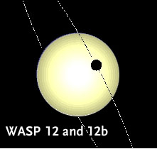
Challenges in Exoplanet Detection for Novice Astronomers
Astronomy enthusiasts and researchers without a deep technical background face challenges in exoplanet detection due to the specialized knowledge required.
This research explores the use of ChatGPT, a Chatbot AI, to assist in overcoming these obstacles in technical knowledge

Slide 3
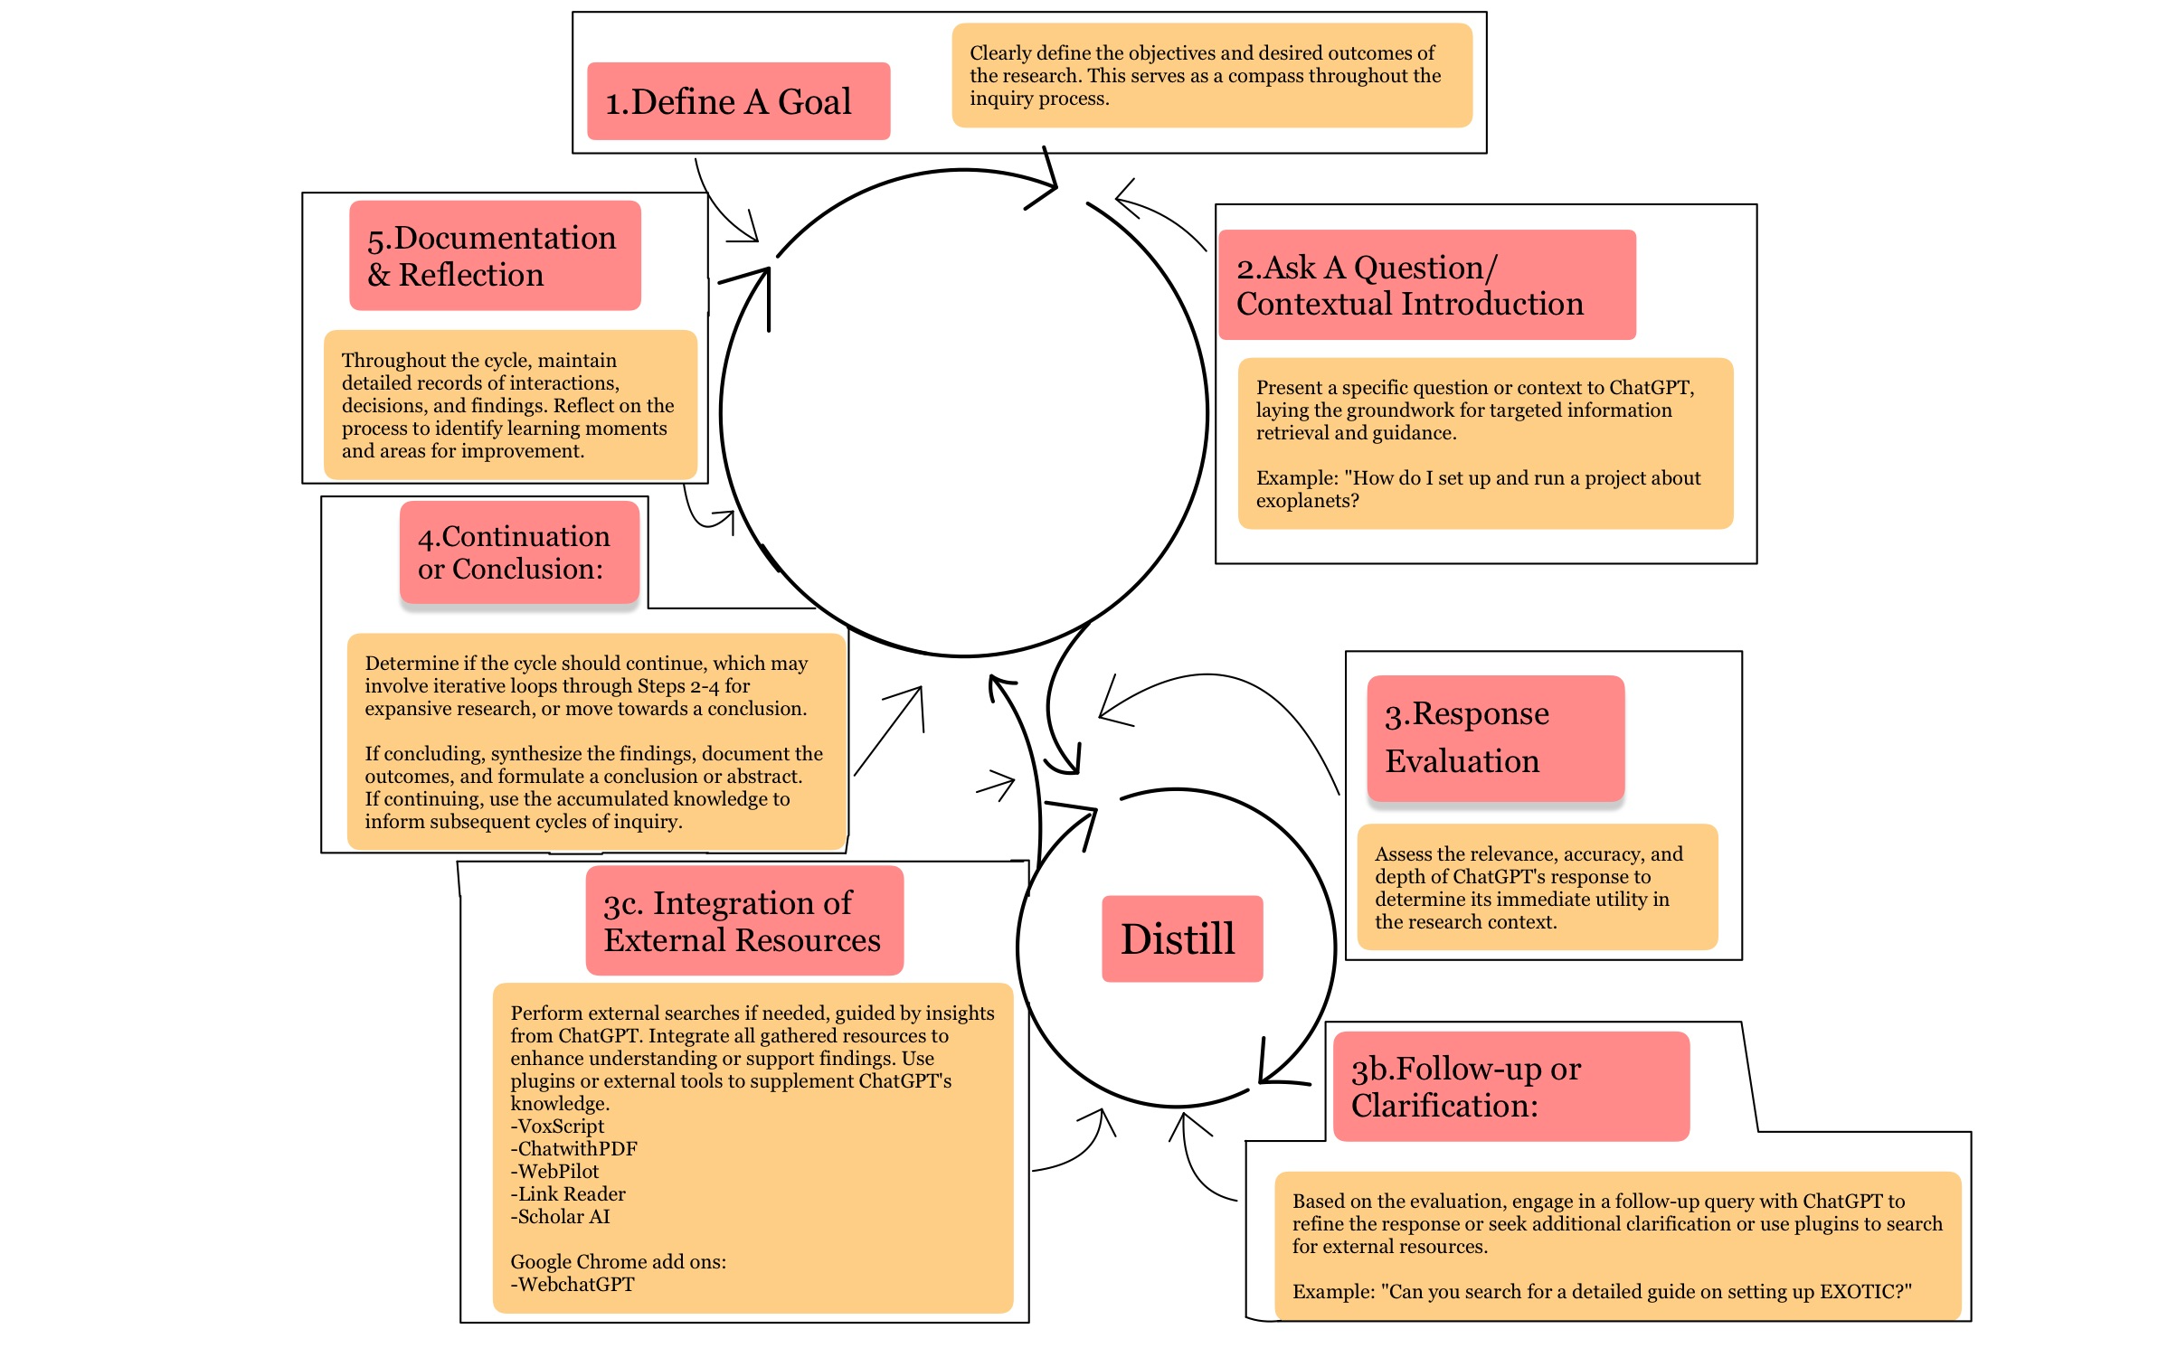
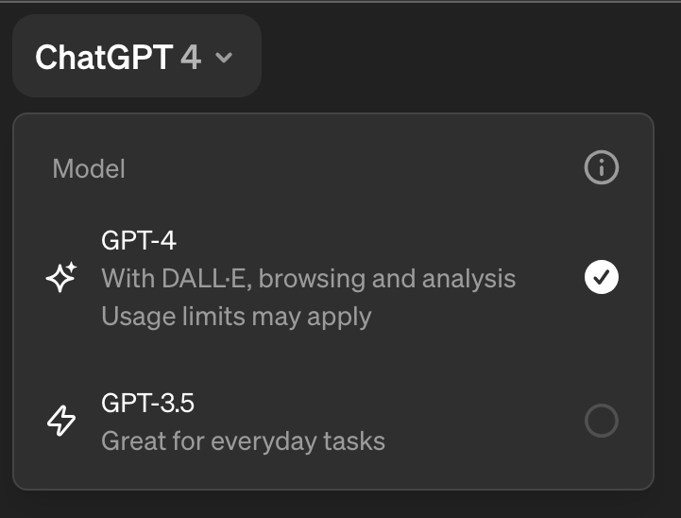
Objectives
The goal is to determine if ChatGPT can serve as an effective bridge in research and understanding, enabling the development of an AI system for the detection and analysis of exoplanets using astronomical datasets.

Slide 4
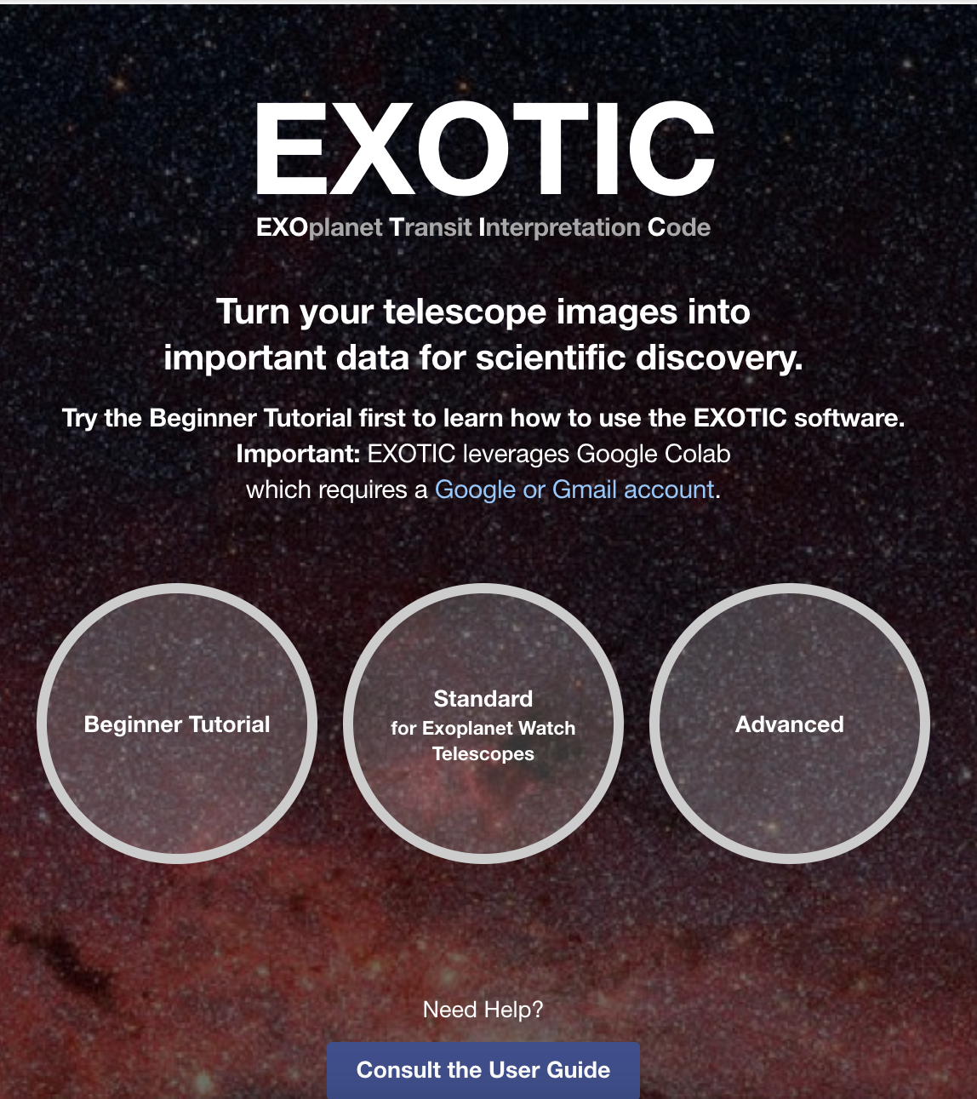
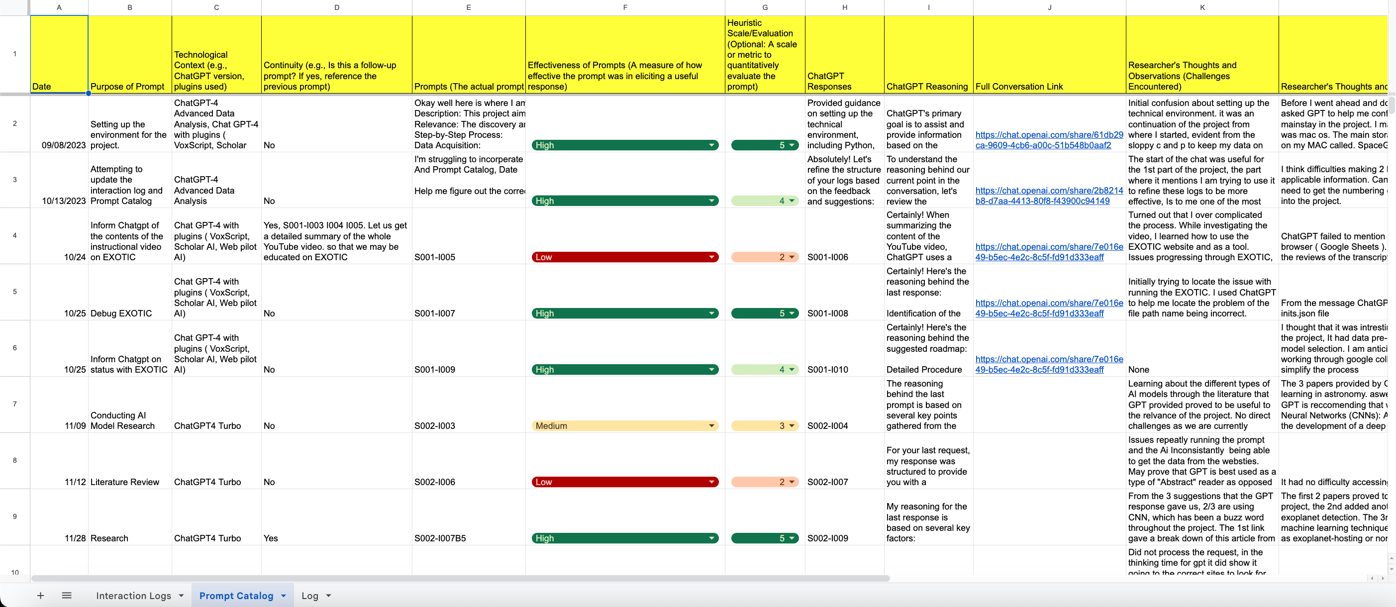
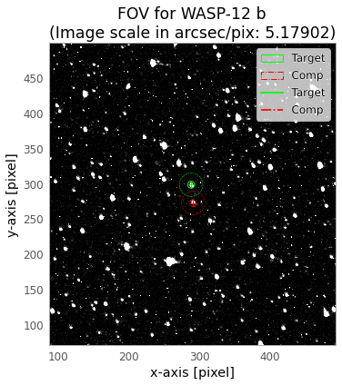
Methods / Activities / Analysis Techniques
The project utilizes an autoethnographic approach with journaling and AI assistance through ChatGPT 4.0 Turbo. Data analysis is conducted using the EXOplanet Transit Interpretation Code (EXOTIC) and datasets from the American Association of Variable Star Observers (AAVSO).
Interactional tools, such as the GPT Inquiry cycle.
Organizational tools, including interaction logs and a prompt catalog, were developed to support research workflow.
The open-source neural network library Keras is explored for developing a Convolutional Neural Network (CNN) algorithm, aimed at enhancing the analysis of exoplanet detection.

Slide 5
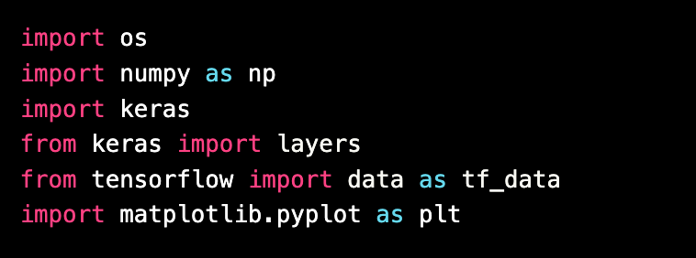
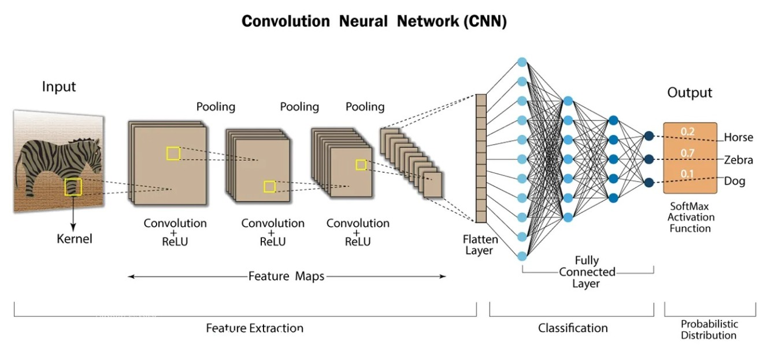
Results
ChatGPT facilitated the acquisition of data on exoplanets like WASP-12 and HAT-P-32, providing a streamlined process to apply EXOTIC for detecting stellar transits.
Although the project identified Keras as a suitable library to create an AI algorithm for exoplanet detection, integration of EXOTIC data with the CNN model was hindered by technical challenges and ChatGPT’s limitations in understanding specific scientific processes.

Slide 6
Interpretations of the Results and Their Significance
The findings highlight ChatGPT's potential as a supportive tool for preliminary research stages, such as data sourcing and initial analysis.
However, the need for human expertise remains evident, especially in tasks requiring technical precision and depth, such as adapting the Keras library to develop an AI model tailored for the nuanced data provided by EXOTIC and AAVSO.

Slide 7
Conclusion and Future Directions
This project underscores the synergistic potential of AI in assisting novice researchers in the field of astronomy. While ChatGPT proved beneficial in organizing and navigating research, its limitations call for continued development and integration with sophisticated AI libraries like Keras.
Future activities may include refining the CNN model's data integration process with EXOTIC outputs, potentially leveraging the advanced capabilities of Keras for better exoplanet detection and analysis

Slide 8
Thank you!

